Slide 1
TELECOM CUSTOMER CHURN
PREDICTION
SUBMITTED BY :
Aakash Sharma

Slide 2
OBJECTIVE
1. Build a Predictive classification model
that will predict Telecom Customer
churn by assessing their propensity of
risk to churn.
2. Comparing different classification Models.
3. Hyper-Parameter Tunning of best Model
selected.

Slide 3
INTRODUCTION
What is Customer Churn ?
Customer churn, also known as customer attrition or customer turnover, refers to the rate at which customers stop doing business with a company or stop using its products or services during a specific period of time.
In other words, it measures the percentage of customers who end their relationship with a business within a given time frame.

Slide 4
Why predicting Customer Churn is crucial for an organization ?
Customer churn is a crucial metric for businesses, as it directly impacts their growth and profitability.
High customer churn rates can be detrimental to a company's success because it means that the business is losing more customers than it is gaining.
Losing customers not only reduces revenue but also increases the cost of acquiring new customers to replace those who have left.

Slide 5
Common reasons for customer-churn in the Telecom Industry
Poor Service Quality
Pricing and Competitive Offers
Lack of Customer Support
Contract Terms and Policies
Technological Advancements
Relocation or Lifestyle Changes
Competitor Offers and Incentives

Slide 6
Different forms of customer churn
Tariff Plan Churn
Service Churn
Product Churn
Usage Churn

Slide 7
High Level overview of Data-Science led Approach to manage churn
CAPTURE
ANALYZE
INSIGHTS
PREDICT
ENGAGE & ACT
Based on Predictive Model Output –
Recommended Subscribers For Targeted Churn Campaign
Business Understanding
Aggregate the Data
Discovers Relationships
Predictive Classification Model Design
Identify Data Requirement
Data Understanding Using EDA
Extract Trends & Patterns
Testing Various
Models
Explore Data Availability
Transform
Data
Detect Anomalies
Choosing Best-Performance
Model
Track
Engage & Act
Request & Extract
Data Required to
Build a model
Deploying & Maintaining The Model
Monitor

Slide 8
EDA STEPS
DATA
COLLECTION
&
GAIN DOMAIN KNOWLEDGE
BASIC INFORMATION ABOUT DATA
UNIVARIATE ANALYSIS
BI-VARIATE ANALYSIS
(i) Datatypes and
missing values
(ii) Measure of Central
tendency
(iii) Measure of
Dispersion
(i) Histogram-kde plots for
Numerical Attributes
(ii) Count-plots for
Categorical Attributes.
(iii) Count-plots for
Categorical Attributes
with hue.
(i) Heatmap - For
Numerical vs
Numerical Attributes.
(ii) Count-plots with Hue -
For Categorical vs
Categorical Attributes .

Slide 9
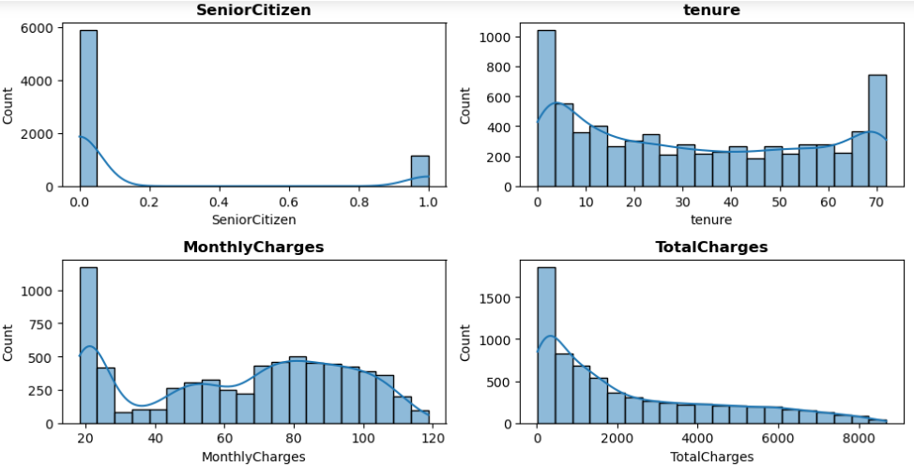
INSIGHTS – Univariate Analysis
(i) Histogram for Numerical attributes
Senior citizens feature :
Binary distribution : 0 & 1
Tenure feature :
Except for peak at the start and end, distribution is more or less uniform.
Montlycharges feature :
Except for the peak at the start,distribution is almost normal
TotalCharges feature :
Distribution is of exponential decay type.

Slide 10
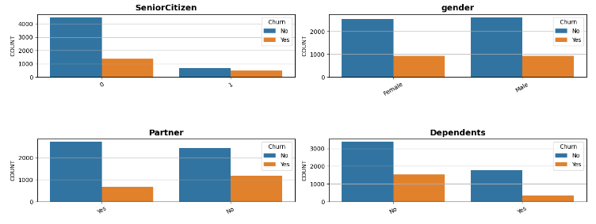
INSIGHTS – Univariate Analysis
(ii) Count-Plots for Categorical attributes with Hue as Churn
SeniorCitizens feature :
Non senior citizens are more likely to churn.
gender feature :
Equally likely to churn.
Partner feature :
Person with no partner are somewhat more likely to churn.
Dependents feature :
Person with no dependent are more likely to churn.

Slide 11
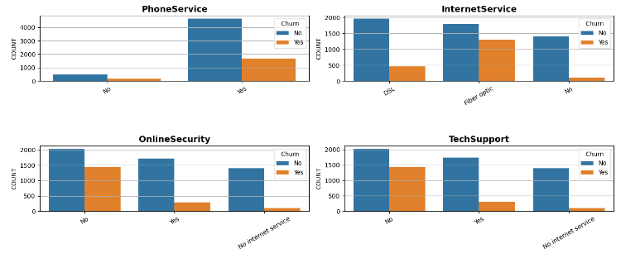
INSIGHTS – Univariate Analysis
(ii) CountPlots for Categorical attributes with Hue as Churn
InternetService feature :
Person with fiber optic are more likely to churn
OnlineSecurity feature :
Person with No online security are more likely to churn
TechSupport feature :
Person with No TechSupport are more likely to churn

Slide 12
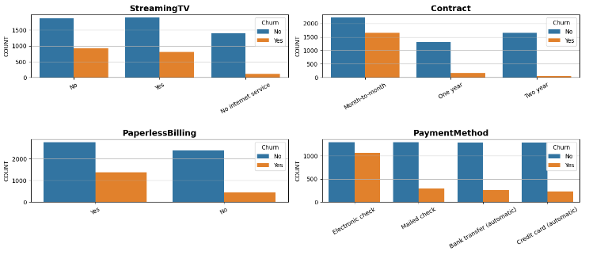
INSIGHTS – Univariate Analysis
(ii) CountPlots for Categorical attributes with Hue as Churn
StreamingTV feature :
Person with No internet service are less likely to churn.
Contract feature :
Person with month-to-month service are more likely to churn.
Partner feature :
Person with PaperlessBilling are more likely to churn.
Dependents feature :
Person with Electronic check are more likely to churn.

Slide 13
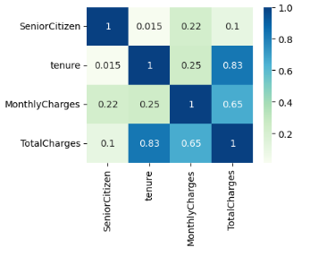

INSIGHTS – Bivariate Analysis
(i) Numerical vs. Numerical → Heat-map or Pair-plot

Slide 14
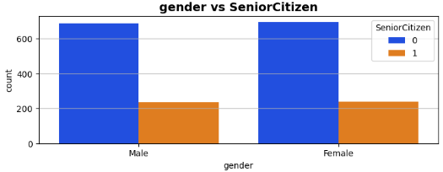
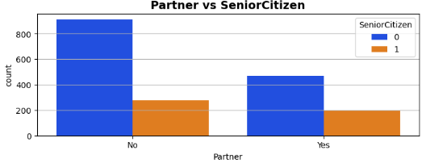
INSIGHTS – Bivariate Analysis
(iii) Categorical vs. Categorical Plots for Churned Customer
(a) Hue : SeniorCitizen
Variable : Gender Hue : Senior Citizen
• Both Male & Female that aren’t Senior-
Citizen are more likely to churn.
Variable : Partner Hue : Senior Citizen
• Subscribers that don’t have Partner & Non-
senior citizen are more likely to churn.

Slide 15
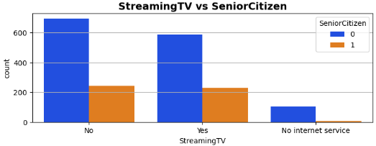
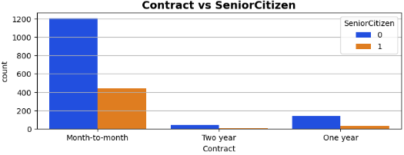
INSIGHTS – Bivariate Analysis
(iii) categorical vs. categorical
(a) Hue : SeniorCitizen
Variable : StreamingTV Hue : Senior Citizen
• Subscribers that are streamingTV or not and are
Non-senior citizen are more likely to churn.
Variable : Contract Hue : Senior Citizen
• Subscribers with month-to-month contract and
are Non senior citizen are more likely to churn.

Slide 16
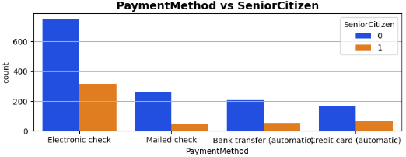
INSIGHTS – Bivariate Analysis
(iii) categorical vs. categorical
(a) Hue : SeniorCitizen
Variable : PaymentMethod Hue : Senior Citizen
• Subscribers that opted for electronic-check payment method and aren’t
senior citizen are more likely to churn.

Slide 17
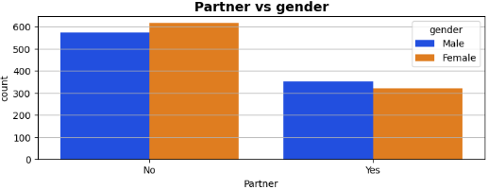
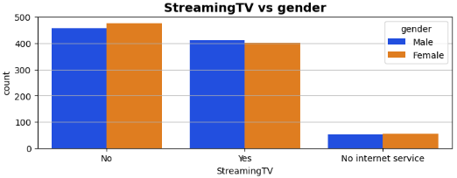
INSIGHTS – Bivariate Analysis
(iii) categorical vs. categorical
(b) Hue : Gender
Variable : Partner Hue : gender
• Both male & female Subscribers that don’t have
Partner are more likely to churn.
Variable : StreamingTV Hue : gender
• Both male & female Subscribers that are
streamingTV or not are equally likely to churn.

Slide 18
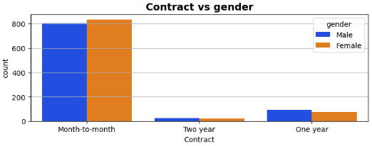
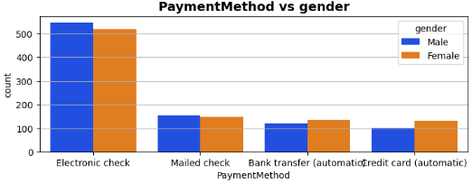
INSIGHTS – Bivariate Analysis
(iii) categorical vs. categorical
(b) Hue : Gender
Variable : contract Hue : gender
• Both male & female Subscribers with month-to-
month contract are more likely to churn.
Variable : PaymentMethod Hue : gender
• Both male & female Subscribers with
Electronic-check Payment Method are more
likely to churn.

Slide 19
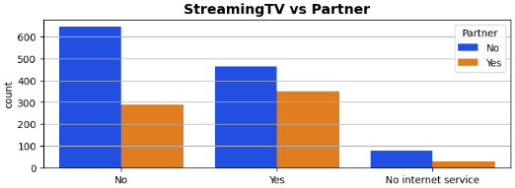
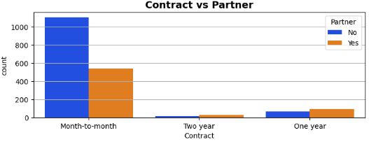
INSIGHTS – Bivariate Analysis
(iii) categorical vs. categorical
(c) Hue : Partner
Variable : StreamingTV Hue : Partner
• Subscribers that don’t have Partner and aren’t
streamingTV are more likely to churn.
Variable : Contract Hue : Partner
• Subscribers that don’t have Partner and opted
for month-to-month contract are more
likely to churn.

Slide 20
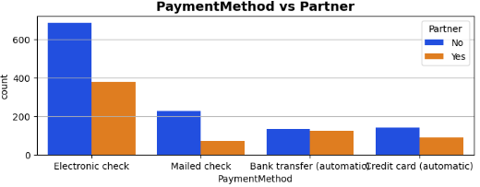
INSIGHTS – Bivariate Analysis
(iii) categorical vs. categorical
(c) Hue : Partner
Variable : PaymentMethod Hue : Partner
• Subscribers that don’t have Partner and opted for Electronic-check Payment
Method are more likely to churn.

Slide 21
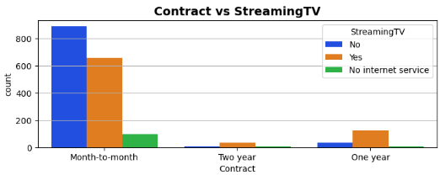
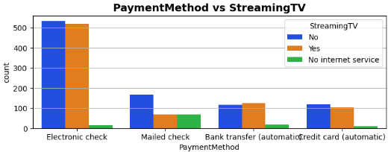
INSIGHTS – Bivariate Analysis
(iii) categorical vs. categorical
(d) Hue : StreamingTV
Variable : Contract Hue : StreamingTV
• Subscribers with month-to-month contract and
are streamingTV or not are more likely to churn.
Variable : PaymentMethod Hue : StreamingTV
• Subscribers that opted for Electronic-check
Payment Method and are streamingTV or not
are more likely to churn.

Slide 22
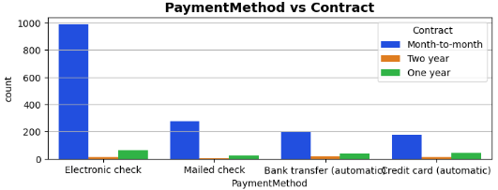
INSIGHTS – Bivariate Analysis
(iii) categorical vs. categorical
(e) Hue : Contract
Variable : PaymentMethod Hue : Contract
• Subscribers that opted for Electronic-check Payment Method and have
month-to-month contract are more likely to churn.

Slide 23
DIFFERENT STAGES
STAGE I
RAW DATA
MODEL I
RESULTS
With:
Pipeline :
- Missing value Imputation
- Ohe.
- Standard Scaling
Imbalance Data
Feature Engineering

Slide 24
DIFFERENT STAGES
STAGE II (A)
RAW DATA
MODEL II (a)
RESULTS
With:
Pipeline :
- Missing value Imputation
- Ohe.
- Standard Scaling
Balanced Data : Up Sampling
Feature Engineering

Slide 25
DIFFERENT STAGES
STAGE II (B)
RAW DATA
MODEL II (b)
RESULTS
With:
Pipeline :
- Missing value Imputation
- Ohe.
- Standard Scaling
Balanced Data : Down Sampling
Feature Engineering

Slide 26
DIFFERENT STAGES
STAGE II (C)
RAW DATA
MODEL II (c)
RESULTS
With:
Pipeline :
- Missing value Imputation
- Ohe.
- Standard Scaling
Balanced Data : Combine Sampling
Feature Engineering

Slide 27
DIFFERENT STAGES
STAGE III
RAW DATA
FINAL MODEL
RESULTS
With:
Pipeline :
- Missing value Imputation
- Ohe.
- Standard Scaling
Balanced Data : Combine Sampling
Feature Engineering

Slide 28
RESULTS
STAGE I : Imbalanced Data
With :
Pipeline :
- Missing value Imputation
- Ohe.
- Standard Scaling
Imbalance Data
Feature Engineering
STEPS :
After EDA following steps are performed :
STEP 1 : Data cleaning & Pre-Processing using Pipeline object.
(a) Missing Numerical value imputation using : SimpleImputer(strategy = Median).
(b) categorical columns to Numerical columns using OneHotEncoder.
(c) Numerical columns Standardization using StandardScaler.
STEP 2 : Model Training and Predictions with Different classification ML algorithms.

Slide 29
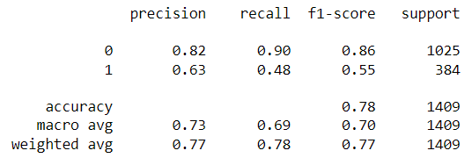
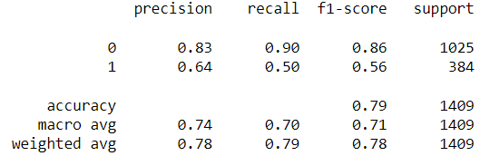
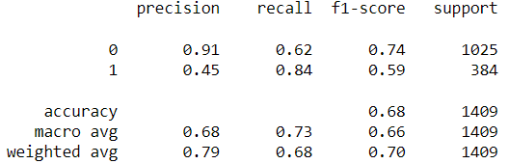
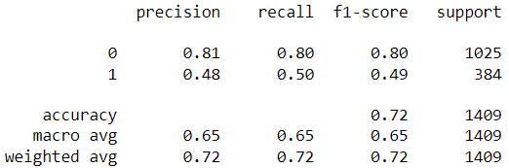
Results : Testing
(a) STAGE I : Imbalanced Data
(i) Logistic Regression
(ii) SVC
(iii) GaussianNB
(iv) DecisionTreeClassifier

Slide 30
Results : Testing
(a) STAGE I : Imbalanced Data
(v) RandomForestClassifier

Slide 31
RESULTS
(a) STAGE II (A) : Balanced Data - UpSampling
With :
Pipeline :
- Missing value Imputation
- Ohe.
- Standard Scaling
Balanced Data - UpSampling
Feature Engineering
STEPS :
After EDA following steps are performed :
STEP 1 : Data cleaning & Pre-Processing using Pipeline object.
(a) Missing Numerical value imputation using : SimpleImputer(strategy = Median).
(b) categorical columns to Numerical columns using OneHotEncoder.
(c) Numerical columns Standardization using StandardScaler.
STEP 2 : Model Training and Predictions with different Up sampling methods have be done.

Slide 32
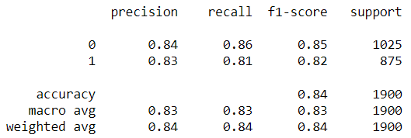
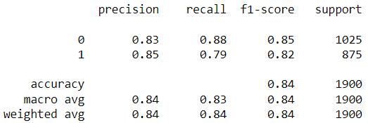
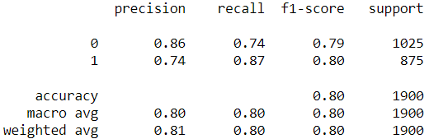
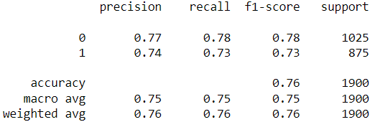
Results : Testing
(a) STAGE II (A) : Best Performing UpSampling method : KMeansSMOTE
(i) Logistic Regression
(ii) SVC
(iii) GaussianNB
(iv) DecisionTreeClassifier

Slide 33
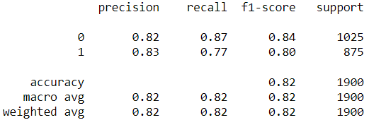
Results : Testing
(a) STAGE II (A) : Best Performing UpSampling method : KMeansSMOTE
(v) RandomForestClassifier

Slide 34
RESULTS
(a) STAGE II (B) : Balanced Data : Down Sampling
With :
Pipeline :
- Missing value Imputation
- Ohe.
- Standard Scaling
Balanced Data – Down Sampling
Feature Engineering
STEPS :
After EDA following steps are performed :
STEP 1 : Data cleaning & Pre-Processing using Pipeline object.
(a) Missing Numerical value imputation using : SimpleImputer(strategy = Median).
(b) categorical columns to Numerical columns using OneHotEncoder.
(c) Numerical columns Standardization using StandardScaler.
STEP 2 : Model Training and Predictions with different Down sampling methods have be done.

Slide 35
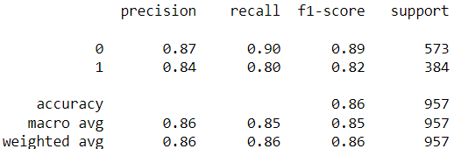
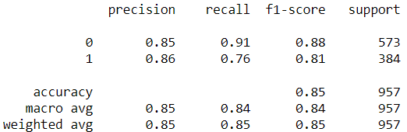
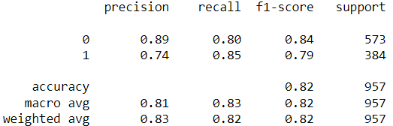
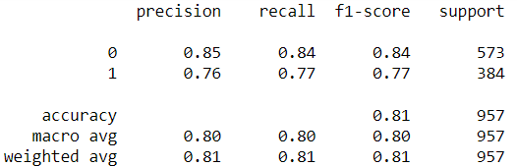
Results : Testing
(a) STAGE II (B) : Best Performing DownSampling Method : ENN
(i) Logistic Regression
(ii) SVC
(iii) GaussianNB
(iv) DecisionTreeClassifier

Slide 36
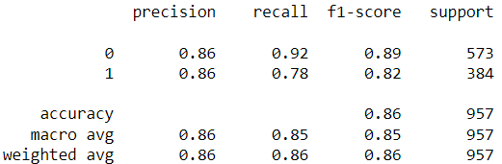
Results : Testing
(a) STAGE II (B) : Best Performing DownSampling Method : ENN
(v) RandomForestClassifier
ENN : EditedNearestNeighbours

Slide 37
RESULTS
(a) STAGE II (C) : Balanced Data : Combine Sampling
With :
Pipeline :
- Missing value Imputation
- Ohe.
- Standard Scaling
Balanced Data – Combine Sampling
Feature Engineering
STEPS :
After EDA following steps are performed :
STEP 1 : Data cleaning & Pre-Processing using Pipeline object.
(a) Missing Numerical value imputation using : SimpleImputer(strategy = Median).
(b) categorical columns to Numerical columns using OneHotEncoder.
(c) Numerical columns Standardization using StandardScaler.
STEP 2 : Model Training and Predictions with Combine sampling method SMOTEENN method
has be done.

Slide 38
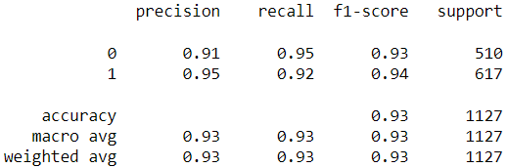
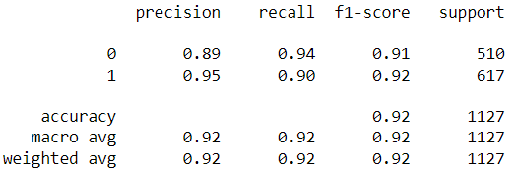
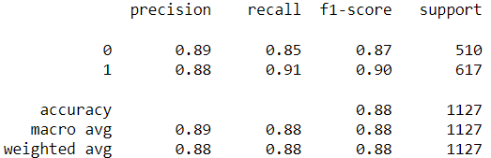
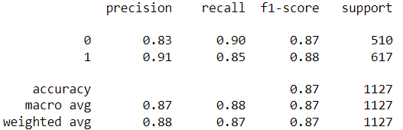
Results : Testing
(a) STAGE II (C) : Combine Sampling method : SMOTEENN
(i) Logistic Regression
(ii) SVC
(iii) GaussianNB
(iv) DecisionTreeClassifier

Slide 39
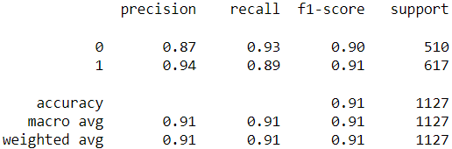
Results : Testing
(a) STAGE II (C) : Combine Sampling method : SMOTEENN
(v) RandomForestClassifier

Slide 40
RESULTS
(a) STAGE III Final Model : Combine Sampling method : SMOTEENN
With :
Pipeline :
- Missing value Imputation
- Ohe.
- Standard Scaling
Balanced Data – Combine Sampling.
Feature Engineering
STEPS :
After EDA following steps are performed :
STEP 1 : Data cleaning & Pre-Processing using Pipeline object.
(a) Missing Numerical value imputation using : SimpleImputer(strategy = Median).
(b) categorical columns to Numerical columns using OneHotEncoder.
(c) Numerical columns Standardization using StandardScaler.
STEP 2 : Model Training and Predictions with Combine sampling method SMOTEEN with
hyperparameter Tuning of Best Performing model has been done.

Slide 41
Results : Testing
(a) STAGE III Final Model : Combine Sampling method : SMOTEENN
(i) Logistic Regression
(ii) SVC
(iii) GaussianNB
(iv) DecisionTreeClassifier

Slide 42
Results : Testing
(a) STAGE III Final Model : UpDown Sampling method : SMOTEENN
(v) RandomForestClassifier

Slide 43
Hyper-Parameter Tuning
Choosing best model - Logistic Regression
CODE :
log_reg = LogisticRegression()
Param_grid = [
{
"solver": ['newton-cg', 'lbfgs'],
"C": [100, 10, 1.0, 0.1, 0.01]
}
]
Custom Function :

Slide 44
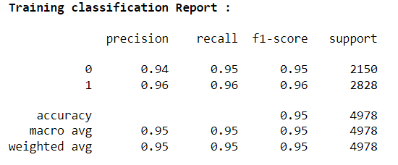
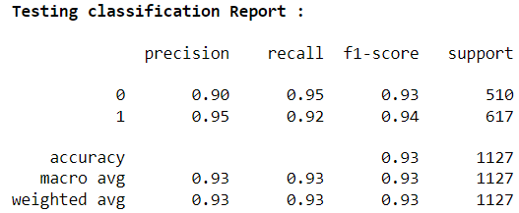
Hyper-Parameter Tuning
Choosing best model - Logistic Regression

Slide 45
CONCLUSION
(1) Imbalance Data
(a) Best Performing ML Model : Logistic Regression & Random Forest Classifier.
(b) Accuracy : 0.79 (both)
(2) Balanced Data
(I) Up-Sampling
(a) Best Performing Up-Sampling Method: KMeansSMOTE
(b) Best Performing ML Model : Logistic Regression & SVC
(c) Accuracy : 0.84 (both)

Slide 46
(2) Balanced Data
(II) Down-Sampling
(a) Best Performing Down-Sampling Method: ENN
(b) Best Performing ML Model : Logistic Regression & RandomForestClassifier
(c) Accuracy : 0.86 (both)
(III) Combine-Sampling
(a) Best Performing Down-Sampling Method: SMOTEENN
(b) Best Performing ML Model : Logistic Regression.
(c) Accuracy : 0.93

Slide 47
(3) FINAL MODEL
(a) Combine Sampling technique is used for sampling the Imbalance Data.
(b) Hyper-Parameter Tuning of Logistic Regression ML Model is done.

